Slide 1

DECENT: A Decentralized Architecture for Enforcing Privacy in Online Social Networks
Sonia Jahid¹, Shirin Nilizadeh², Prateek Mittal¹, Nikita Borisov¹, Apu Kapadia²
¹University of Illinois at Urbana-Champaign
²Indiana University Bloomington
Presented by: Sonia Jahid
SESOC, 2012

Slide 2
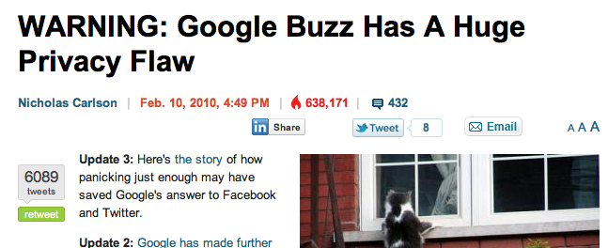
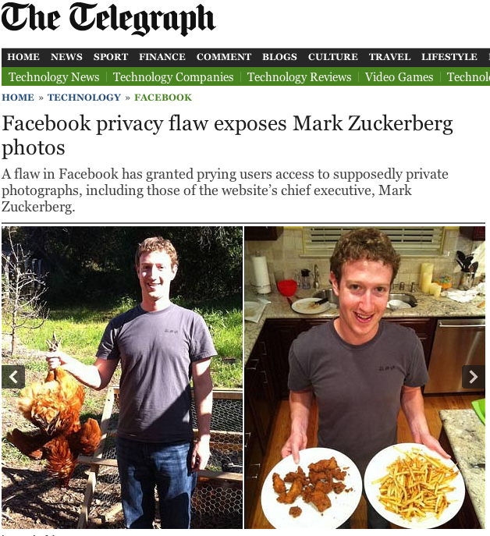

Privacy Issues

Slide 3
Decentralization - Challenges
Availability
Access control by others
Confidentiality/Integrity
Malicious activities
Myself
Provider
Hybrid
Trusted Party
Existing Research
Diaspora* [http://joindiaspora.com]
LotusNet [Aiello et al. ’12]
SafeBook [Cutillo et al. ’09 ]
PeerSoN [Buchegger et al. ’09]
Persona [Baden et al. ’09]
Untrusted Party
DHT
Cryptography

Slide 4
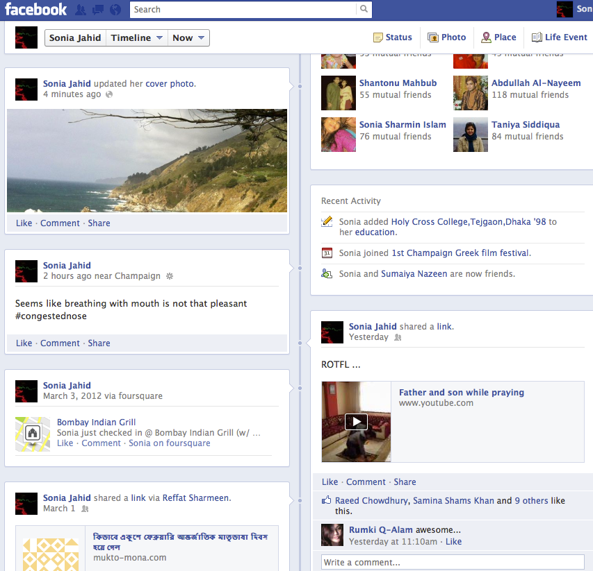
OSN Data is complicated
Wall
Status
Video
Link
Comment

Slide 5
Our Contribution
Address the challenges
Decentralization of the OSN architecture
Advanced cryptography
Other design philosophes

Slide 6

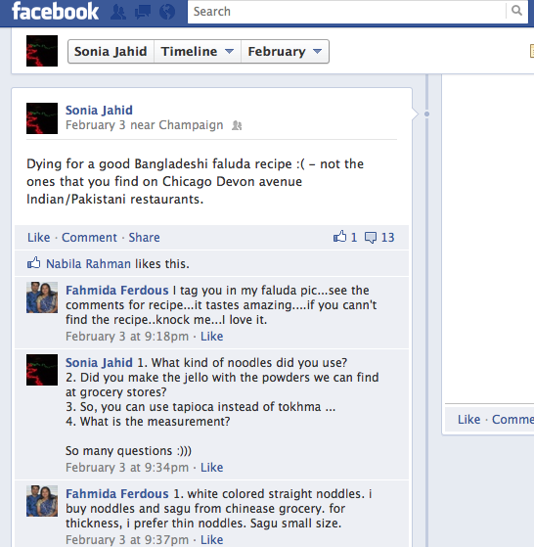
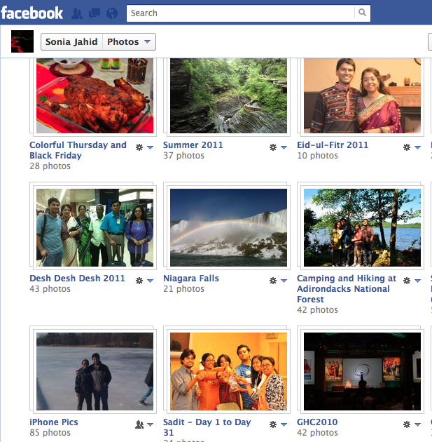

Design – Data Structure
Alice’s Status
Object
Data
Policy
ReferenceList
Status Message
Read
Write/Delete
Append
Friend or Family Alice|Friend & Family
ID, Read-Policy, Write-Policy
CommentReference
Object
Like!
Friend or Colleague|Bob|Friend
Bob’s Comment

Slide 7
Design – Privacy Policy
Alice
Alice
Bob
Wall
Policy
ReferenceList
Status
DECENT rocks!
Friend and Family
CommentReference
Comment
Like!
Colleague or Neighbor
StatusReference₁
Restrictive Policy on comments

Slide 8




Design - DHT
Provides
Storage/Lookup Operation
Availability
Append Operation
Verifies
Write policy
Append policy
Can not
Relate data to its owner
Figure out data owner’s social graph

Slide 9






Design – Confidentiality and Integrity
OR
Attribute-based Encryption
User-defined attribute-based policy
Frequent revocation
1
AND
Colleague
Friend
Neighbor
Alice
Bob
Carol
Diana
friend,
neighbor
colleague
friend,
colleague

Slide 10
Design – Confidentiality and Integrity
Alice’s Object
Integrity
Write Policy – set to the owner
Request signed with Write-Secret-Key
Verified by readers
Append Policy – attribute-based
Comment-reference signed with Append-Secret-Key
Verified by readers
Confidentiality
ABE
Write-Public-Key
Append-Public-Key
E_{Alice}(Write-Secret-Key)
ABE
ABE(Append-Secret-Key)
Data
Sign
Sign(CommentRef₁)
Sign (CommentRef₂)

Slide 11
Implementation and Evaluation
Prototype in Java
Simulation - FreePastry Simulator
Experiments on PlanetLab – Kademlia
Cryptography
Progressive Lookup
Simulation (60 Statuses)
Experiment on PlanetLab (12 Statuses)

Slide 12





Conclusion
Contribution
Design and prototype of a decentralized OSN
Preliminary performance results
Ongoing Work
Optimizations in cryptography and DHT Lookup
Shirin Nilizadeh
Prateek Mittal
Apu Kapadia
Nikita Borisov

